Slide 1





GROUP 7
PLAZA DE CINE
DBMS PROJECT
CSE 302 SESSIONAL

Slide 2



GROUP 7 MEMBERS
202114006
Afra Anan
202114008
Ahmad Abdullah
202114016
Boshita Roy BInti
Member#1
Member #2
Member#3
202114036
Maisha Tabassum
202114062
Mehmil Khan
Member#4
Member #5

Slide 3


TOPIC OUTLINE
Introduction
Parent Tables
ER Diagram
Relational Tables
Schema Diagram
Features

Slide 4

INTRODUCTION
The project's primary goal is to design and create a user-friendly movie theatre management system, a computerized system that is effective and simple to use. The main aim of our system is to provide customers with a means of showing current movies schedules & forthcoming movies,searching, registration, login and pre-booking.
It is a web-based program. We consider that the user will be more effective if they can easily access and use the system. Admins can use the system to add and remove data, which will update the webpage in accordance with the data in the database.

Slide 5


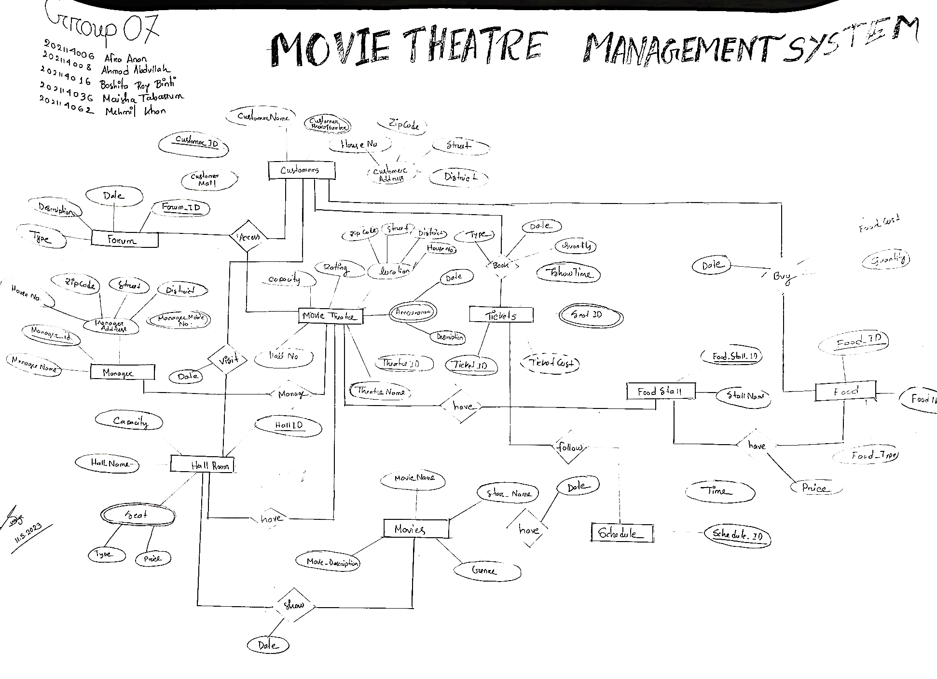
ER DIAGRAM

Slide 6
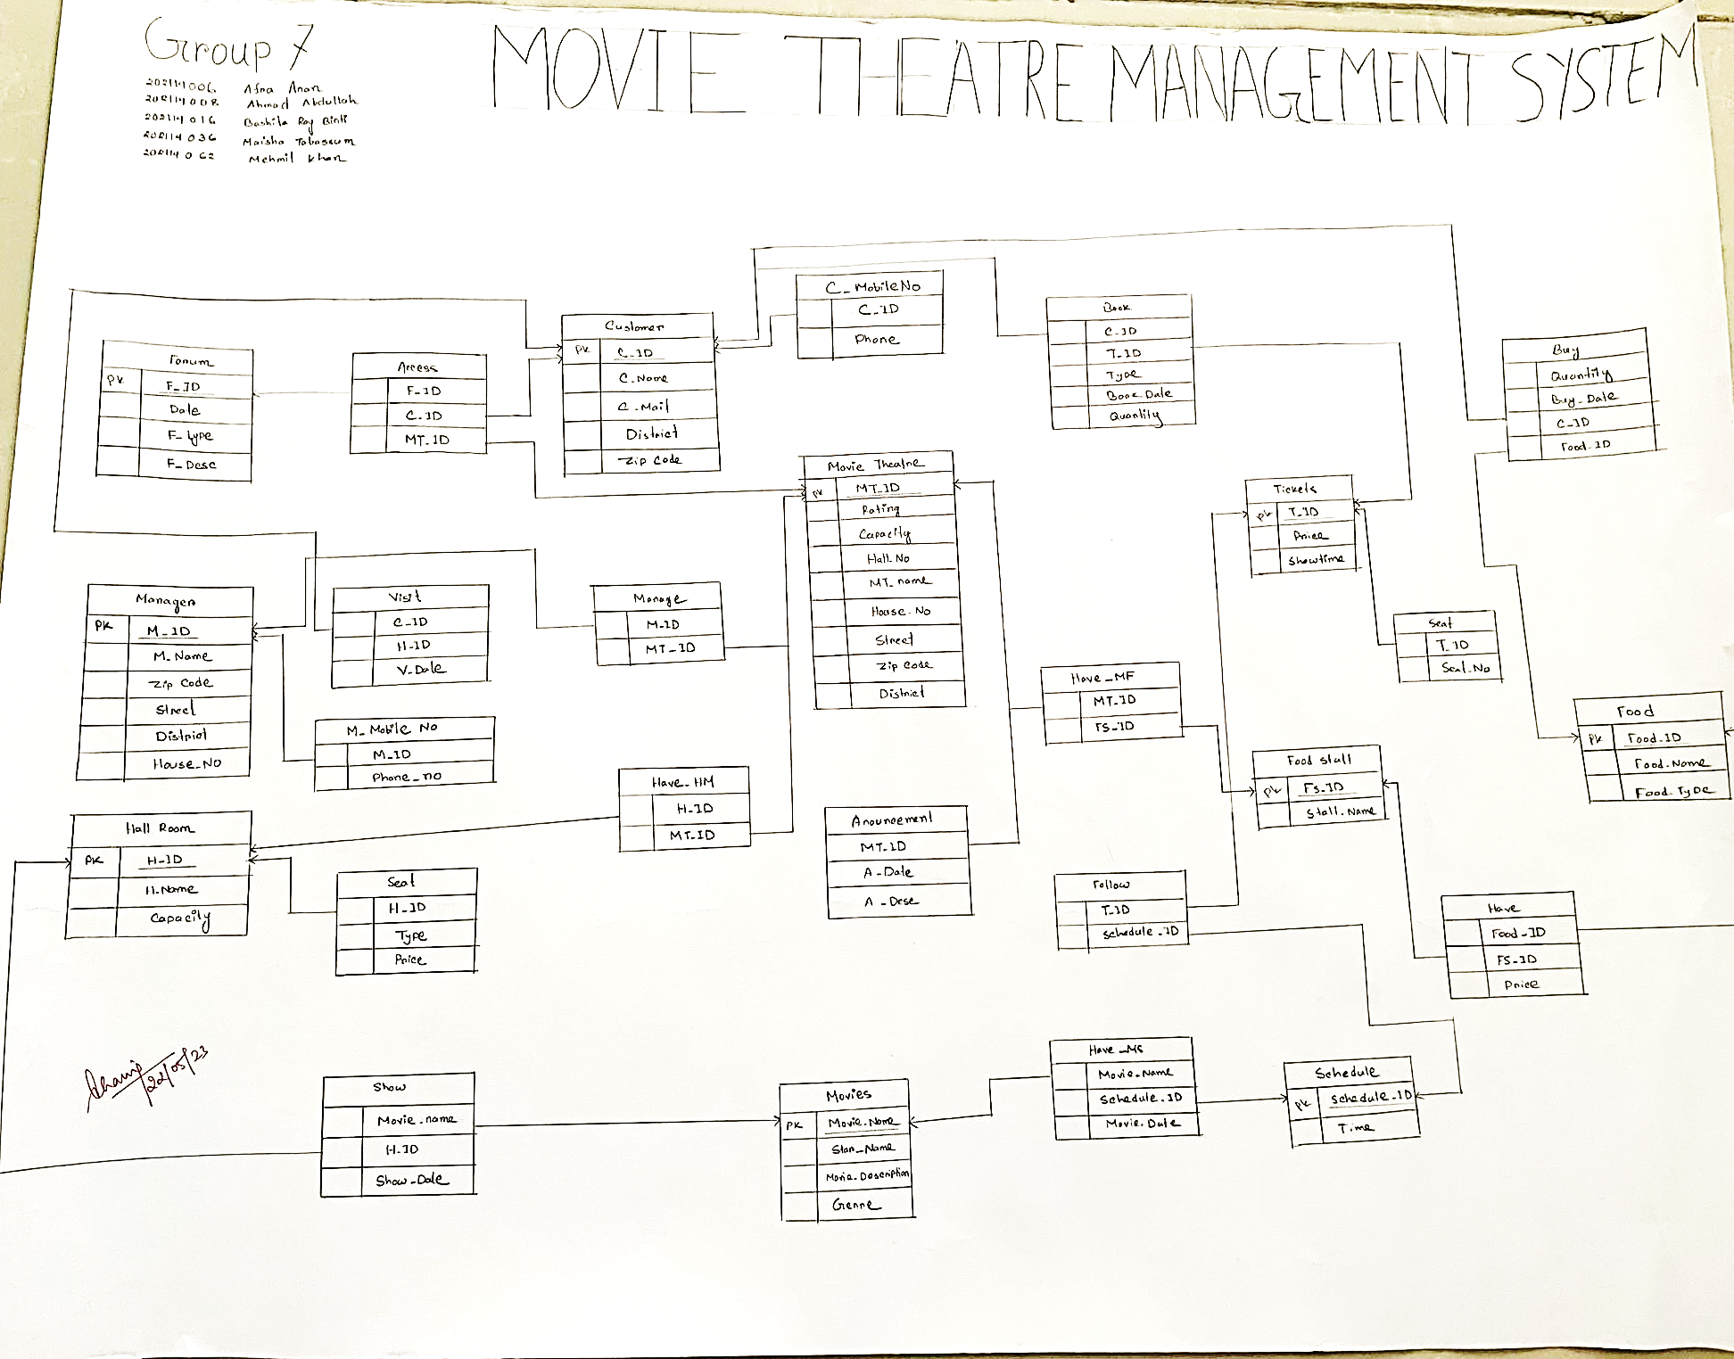
SCHEMA DIAGRAM

Slide 7



PARENT TABLES
Food
Schedule
Tickets
Seat_C
Announcement
C_mobile_no
M_mobile_no
Movie Theatre
Customers
Manager
Forum
Hall Room
Movies
Food Stall

Slide 8
RELATIONAL TABLES
Visit
Axes
Have_HM
Show
Manage
Buy
Book
Have_MF
Follow
Have_MS
Have

Slide 9
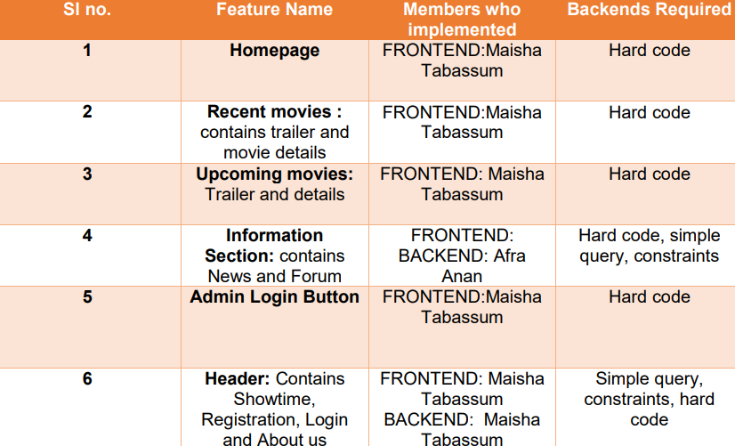
HOMEPAGE

Slide 10


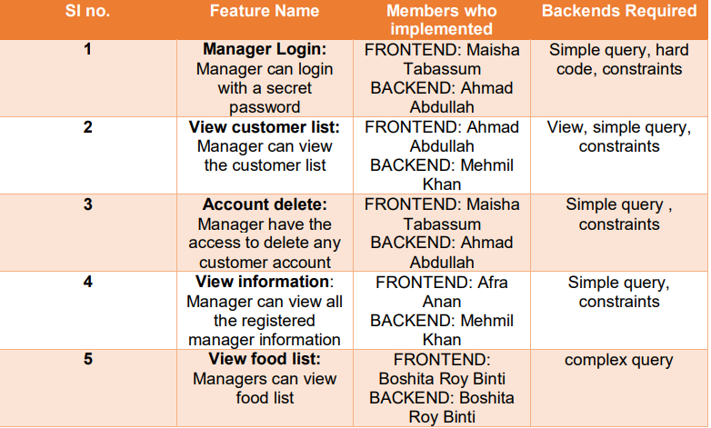
MANAGER

Slide 11
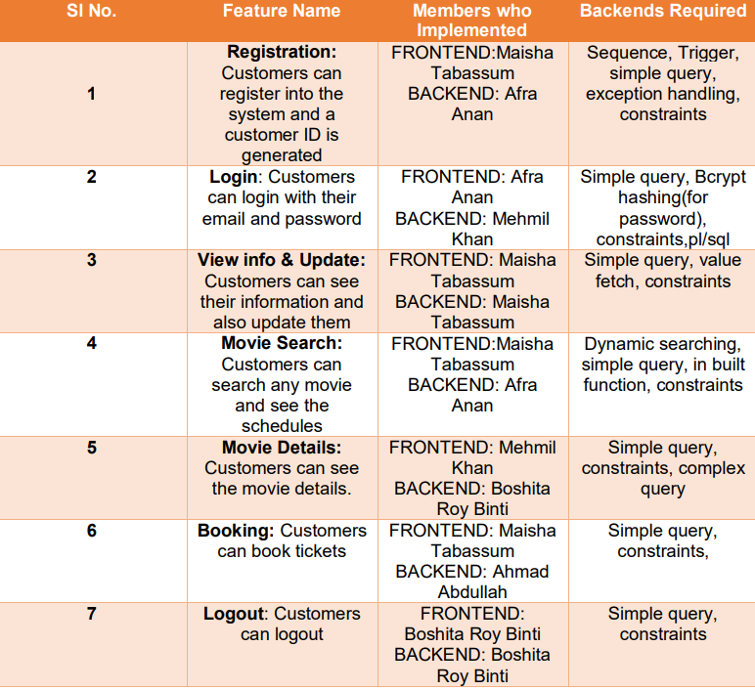

CUSTOMER

Slide 12




THANK YOU

